Slide 1
ONLINE HOTEL RESERVATION SYSTEM
Group No : 11
Computer Science and Technology

Slide 2
Content……..
1. INTRODUCTION
1.1 Project Background
1.2 Project aims/objectives
1.3 Main features of the system
2. UML DIAGRAMS
2.1 Class Diagram
2.2 Use Case Diagram
3. ER DIAGRAM
4. PROGRESS OF THE PROJECT
4.1 Description on the work
5. FUTURE WORKS
6. INDIVIDUAL CONTRIBUTION

Slide 3
Project Background
ARALIYA is a 50 room standard imaginary hotel with 3 luxury reception halls. The hotel is using a traditional way of reserving a room. The receptionist uses the log book to know if there is room vacancy. We make this Hotel Reservation System because of the easy use for customers. They can directly go to this web application and reserve rooms and reception halls by their selves.
This is a very efficient method. If a receptionist does all these jobs she has task lots of questions from the customers to fulfill their requirements.
Through the use of computerized hotel reservation system, the receptionist will easily locate the vacant room and assigned it to the client or customer.
Customer also can choose a room for their preferences with their own.

Slide 4
Project aims / objectives :
The hotel reservation system will provide services to customer, receptionist, and an administration. Customers can make searches, reservations and cancel an existing reservation from the hotel reservation web application. Administrator can add/update the hotel and room information.

Slide 5
Main features of the system
Save the client’s information into the database prior to Booking or Check in.
Customize the type of Hotel rooms with prices.
Booking for the customer for specific date with advance.
Can pay payments through credit/debit cards.
After a successful payment or successful reservation customer will receive an email/message from the system.
Check in into the hotel for the duration.
Checkout from the hotel after payment operation.
Each time make a reservation, room status is updated and the customer details are added to the hotel database.

Slide 6
UML Diagrams………

Slide 7
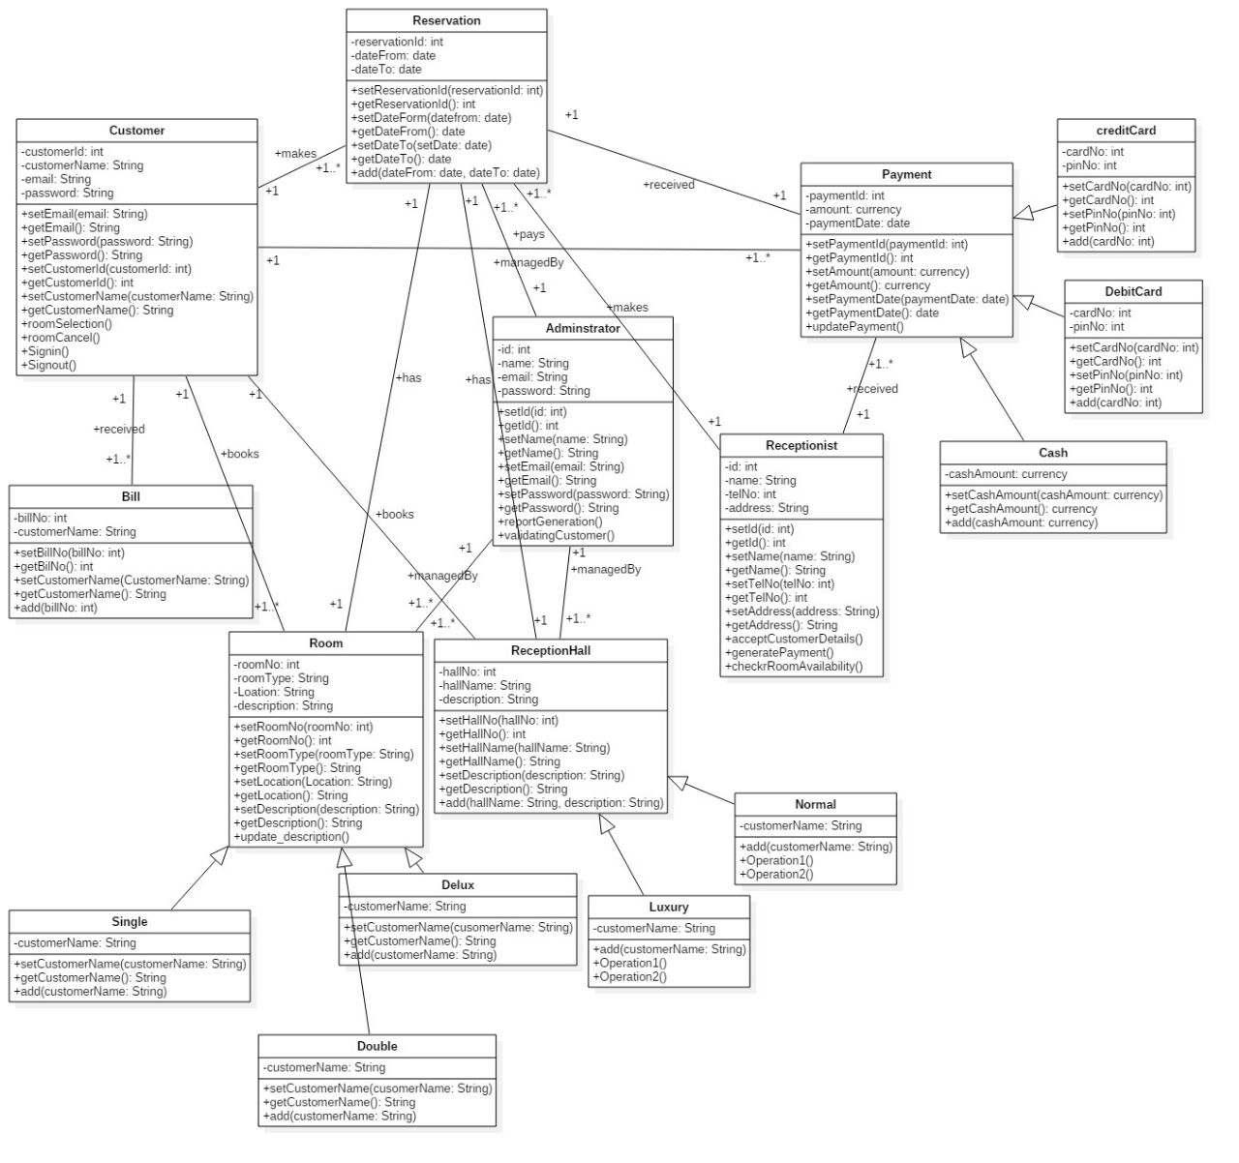
Class Diagram

Slide 8
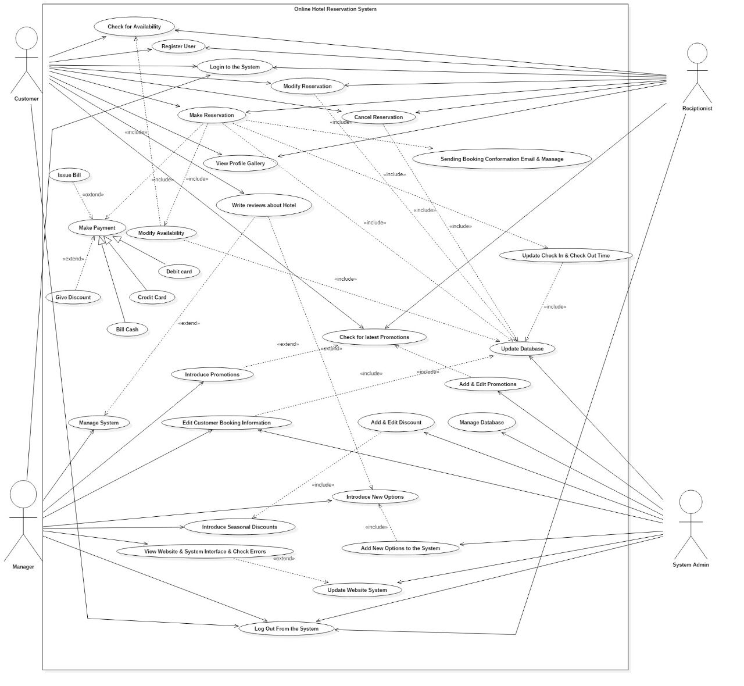
Use-Case Diagram

Slide 9
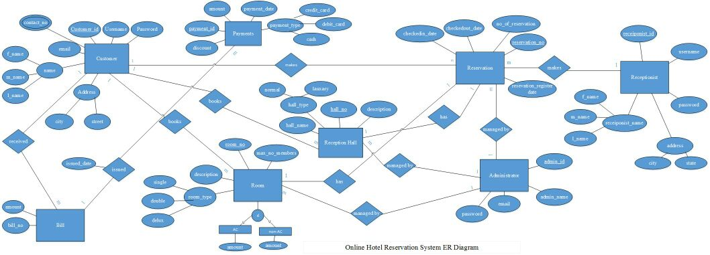
ER Diagram

Slide 10
PROGRESS OF THE PROJECT
Design the Class diagram, Use Case diagram and ER diagram.
Design the database structure.
Design tables for the database.
(Customer, login, registration, room, reception_hall, reservation, user, bill, payments, bill_payment, receptionist, admin)
Design interfaces.
(Home, Book_rooms, Book_halls, Contact us, About us, Gallery, User_login, Registration, Payments, Adimin_Interfaces)
Implement some functionalities.
*User login, Admin login
*User registration details are successfully save in database
*Logout
*Complete some validations

Slide 11
FUTURE WORKS
Develop​ ​code​ ​for​ ​completed​ ​user ​interfaces.
Do​ ​system​ ​testing​ ​after​ ​hosting​ ​database​ ​on​
​internet​ .
Do​ ​integrated​ ​system​ ​testing​ ​with​ ​desktop​ ​
application
Remaining implementations of the functions should be done.
Validations and the verifications should be done
Develop and finalize the hotel reservation system.

Slide 12
Individual Contribution
No | Registration Number | Name | Individual Contribution
1 | UWU/CST/15/013 | Jayasinghe K. C. | Designed and implement the database , Design class diagram and Use Case diagrams, Do documentation.
2 | UWU/CST/15/024 | Mahadeva S. | Design interface ‘Gallery’, Design ER diagram , Do documentation.
3 | UWU/CST/15/036 | Priyadarshana L. P. K. R. | Design interfaces for admin. Implement Use Case Diagram
4 | UWU/CST/15/049 | Thanish M. M. M. | Implement class diagram
5 | UWU/CST/15/060 | Senadheera H. L. | Design all Interfaces for customer and implement use case diagram

Slide 13
THANK YOU…………!

